Slide 1
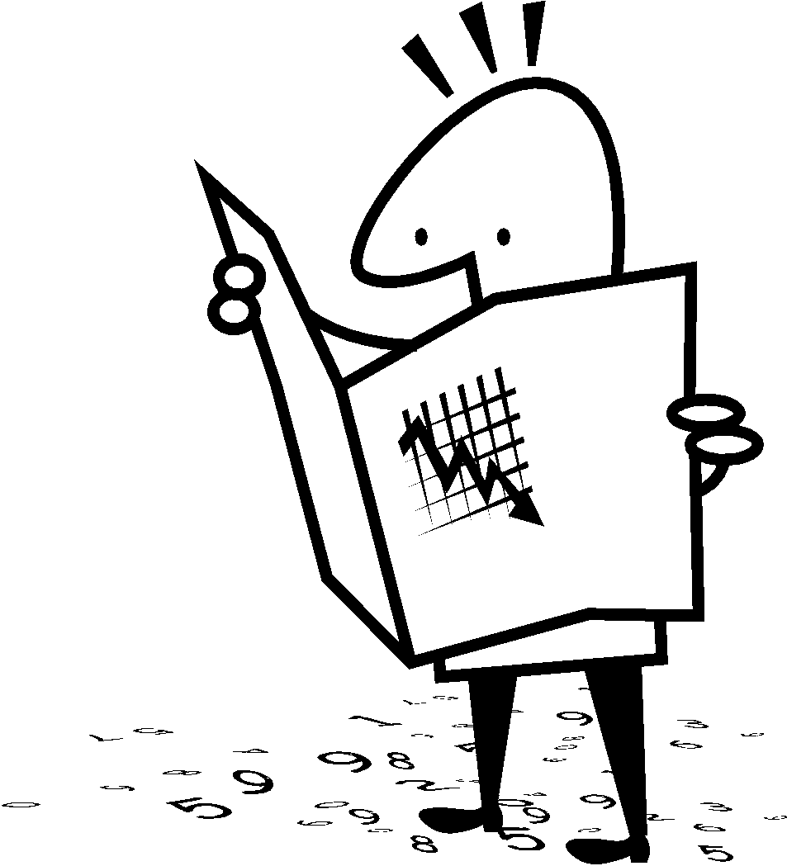
Identifying the Elements of A Plot Diagram
Student Notes
RL8.2

Slide 2
Plot Diagram
3
4
2
1
5

Slide 3
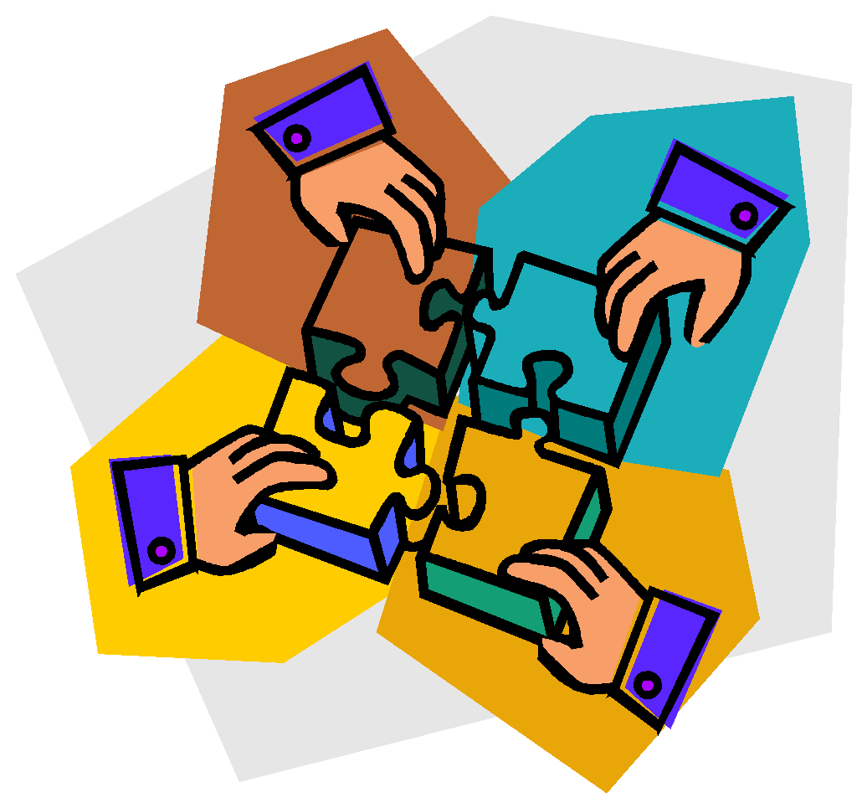
Plot (definition)
Plot is the organized pattern or sequence of events that make up a story. Every plot is made up of a series of incidents that are related to one another.

Slide 4
1. Exposition
This usually occurs at the beginning of a short story. Here the characters are introduced. We also learn about the setting of the story. Most importantly, we are introduced to the main conflict (main problem).

Slide 5
2. Rising Action
This part of the story begins to develop the conflict(s). A building of interest or suspense occurs.

Slide 6
3. Climax
This is the turning point of the story. Usually the main character comes face to face with a conflict. The main character will change in some way.

Slide 7
4. Falling Action
All loose ends of the plot are tied up. The conflict(s) and climax are taken care of.

Slide 8
5. Resolution
The story comes to a reasonable ending.

Slide 9
Putting It All Together
1. Exposition
2. Rising Action
3. Climax
4. Falling Action
5. Resolution
Beginning of Story
Middle of Story
End of Story

Slide 10
Now it’s your turn

